Slide 1
Parallel winding
Furkan Tokgöz

Slide 2
Parameters
L= 0.8 mH
I= 4 A
ΔI=0.4 A
J= 400 A/cm^2
f=50 kHz
ΔT=50 C

Slide 3
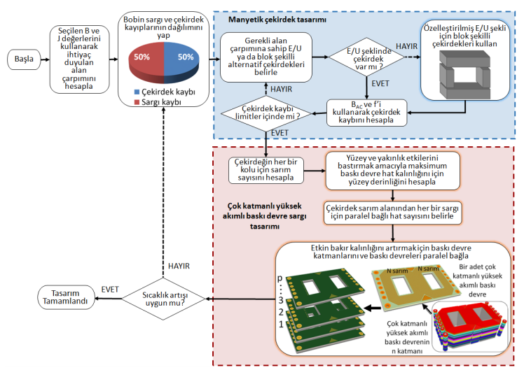

Slide 4

Design Procedure
$L.I.I_{RMS}=k_{cu}.J_{RMS}.B.{(A}_{w}A_{core}$)
${(A}_{w}A_{core}$)=4.425 cm^4

Slide 5
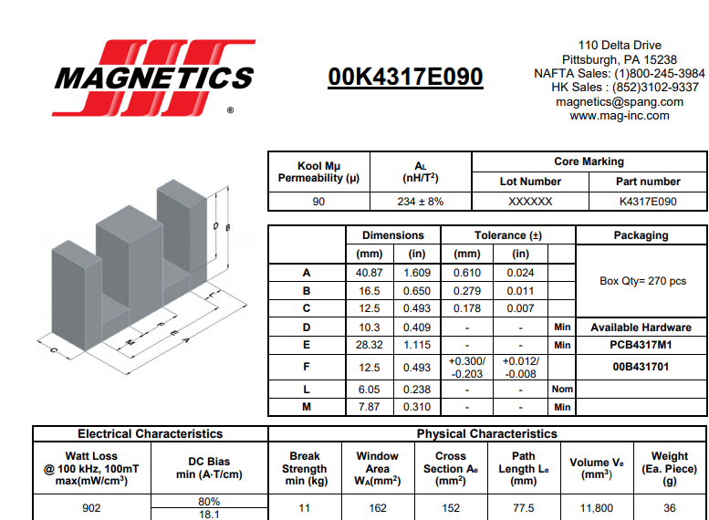

Core selection
${(A}_{w}A_{core}$)=4.9248

Slide 6
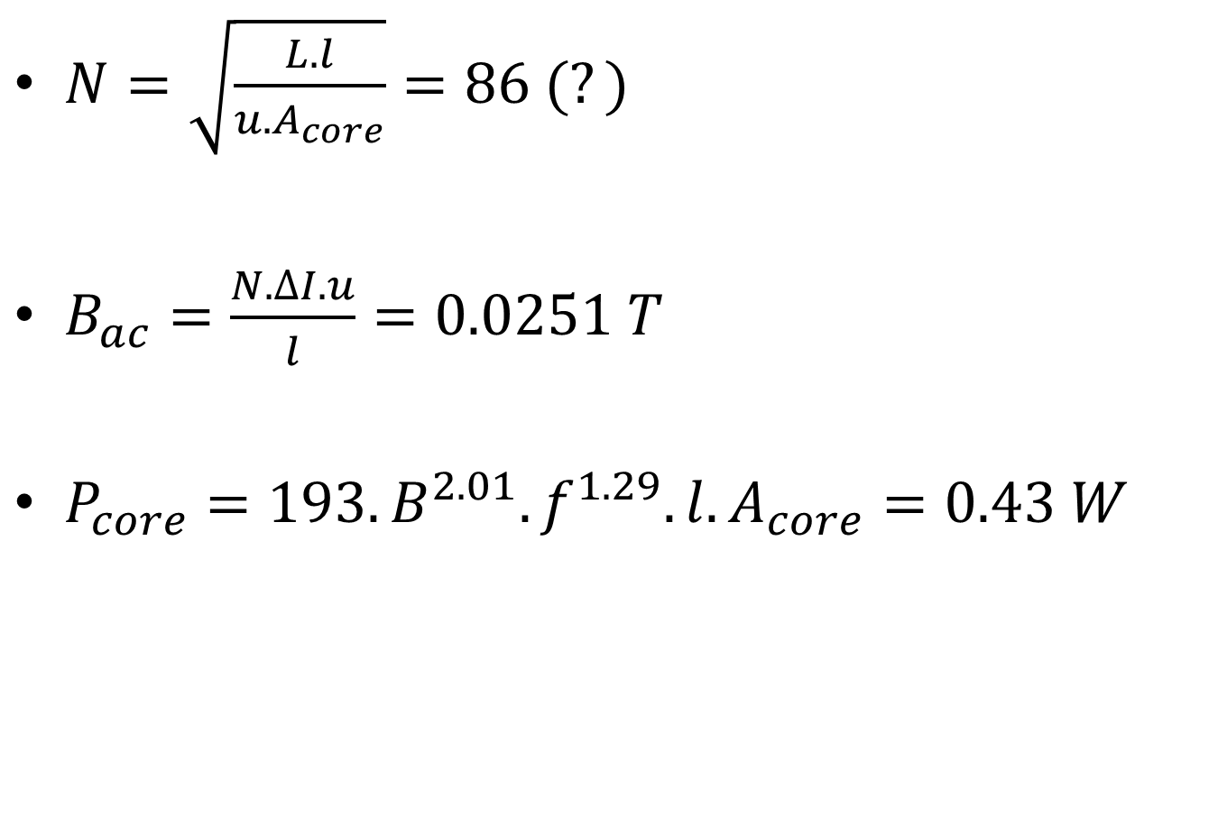
Core loss
$N=\sqrt{\frac{L.l}{u.A_{core}}}=86 (?)$
$B_{ac}=\frac{N.∆I.u}{l}=0.0251 T$
$P_{core}=193.B^{2.01}.f^{1.29}.l.A_{core}=0.43 W$

Slide 7
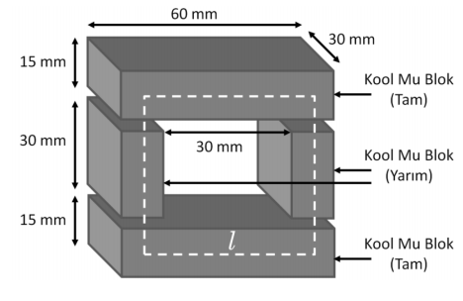
Core
Fig.1. Designed core with 3 core blocks

Slide 8
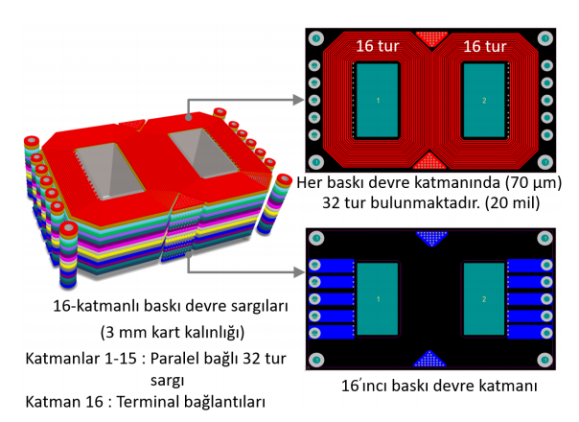
Winding
Fig.2. Winding configuration

Slide 9
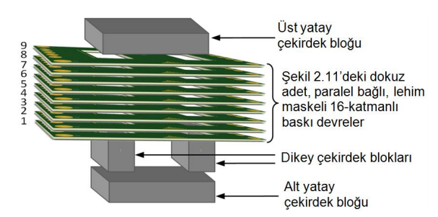
Winding
Fig.3. Complete inductor

